Slide 1

Do Changes in Traits Imply Changes in Behavior: A Longitudinal ESM Study
Emorie D Beck & Joshua J Jackson
Washington University in St. Louis
Notes:
Hello everyone, my name is Emorie Beck, and today I’ll be talking to you about correlated change, or whether self-reported changes in personality are all in our heads.

Slide 2
Extraversion
Agreeableness
Conscientiousness
Neuroticism
Openness
Trait
Roberts et al., 2006
Notes:
When we talk about personality, we often examine it through the lens of the Big 5 *click* Extraversion, Agreeableness, Conscientiousness, Neuroticism, and Openness to Experience
These measures define between person differences, or how people tend to differ from one another, on average.
The Big 5 have been thoroughly examined longitudinally, and there are reliable normative trends in them that are expected across the lifespan, including modest consistency in some facets of Extraversion, increases in Agreeableness and Conscientiousness, particularly in young adulthood, declines in Neuroticism, and early shallow increases in Openness to Experience.

Slide 3

Mean-Level Personality
State
Trait
(self-reports)
Self-Knowledge
Behaviors
Notes:
Most often, trait level assessments use self-report in which people report on their own dispositional charactersitics. There are a number of biases associated with such retrospective reports, including that they rely on your knowledge of yourself, or how you think you tend to behave.
In recent years, there’s been increasing attention afforded to alternative forms of personality assessment. One form is alternately termed experience sampling, ambulatory assessments, or ecological momentary assessments. Unlike trait level measures, ESM assesses state manifestations of personality. Instead of reporting what you do dispositionally, you report what you just did or are doing in the moment.
There is evidence that composites of state level measures of personality map on reasonably well to trait level measures, but there are important differences that suggest that self-knowledge plays a role in reporting.

Slide 4
Longitudinal Personality Change
Extraversion
Agreeableness
Conscientiousness
Neuroticism
Openness
Trait
Self-Knowledge
Notes:
But given the strong evidence of normative change across the lifespan, which reflects changes in the way people see themselves dispositionally over time,

Slide 5
Longitudinal Personality Change
State
Behaviors
?
Trait
Self-Knowledge
Notes:
it is reasonable to wonder whether state level assessments show similar patterns of change.
In other words, over time, do people report changes in their manifestations of personality that reflect their self-reported dispositional changes.
This is critical for two reasons. First, personality and perosnality change are inconsistently linked with outcomes, which creates a question of what we're actually assesing iwth trait measures. Thus, we can use state assessments to validate whether these changes are real.
Second, bottom up behavioral change has been suggested as the means of personality trait change. Thus, determining whether changes in behavior map onto to dispotional changse represents a first step into understanding the underlying processes of personality change and whether the mechanisms lie in low level behavioral change.
We assume that these dispositonal changes are real, but wihtout looking at actual behaviors, we dont know if change is in your head

Slide 6
Longitudinal Personality Change
Is there stability in state measures across time?
Are there individual differences in change of state measures?
Are state and trait change associated with one another?
Notes:
add a sentence unpacking
1. there are very few studies looking at these over time. ESM validated cross-sectionally. DO they have test-rtest etc
2. in trait measures there are normative trends but there are individual differences. Are there interindividual diffeernces in intrainvidual change
3. one way to validate the trait changes is to test whether someone who increases in trait assesments also shwo it in ESM

Slide 7
Longitudinal Personality Change
State
Behaviors
Is there stability in state measures across time?
Are there individual differences in change of state and trait measures?
Are state and trait change associated with one another?
?
Trait
Self-Knowledge
Notes:
In other words, over time, do people report changes in their manifestations of personality that reflect their self-reported dispositional changes. Determining whether this is the case represents a first step into understanding the underlying processes of personality change and whether the mechanisms lie in low level behavioral change. [such as meta-analytic evidence of that personality changes following psychotherapy.]

Slide 8
E_{T1}
E_{T2}
E_{T3}
E_{T4}
E_{T5}
E_{T6}
E_{T7}
I_{TE}
S_{TE}
I_{SE}
S_{SE}
E_{T1}
E_{T4}
E_{T7}

Slide 9
Methods
3 waves of ESM responses and 7 waves of survey responses from the Personality and Interpersonal Roles Study (PAIRS)
N = 434 Wash U undergrads,
Total ESM assessments N = 18,463 (median = 31 responses)
Total survey assessments N = 1301 (median = 3 responses)
Measures
9 items from the Big Five Inventory (BFI)
Procedure
State: 4 assessments / day for 15 days at 3 time points, 1 year apart
Trait: 1 assessment at 7 time points, 3 months apart
Total Assessment Period: 2 years
Notes:
434 undergraduates at Washington University in St. Louis completed both trait level and ESM measures as a Part of the Personality and Intimate Relationships Study. For trait measures, they responded to the full BFI, while they responded to a subset o 9 items from the BFI for state assessments., that represented 4 of the big 5 (openness excluded) Here, we restrain the trait level assessments to the same 9 items used in the state assessments for consistency

Slide 10
Extraversion
Agreeableness
Conscientiousness
Neuroticism
Openness
Trait_{T1}
Trait_{T2}
Trait_{T3}
Trait_{T4}
Trait_{T5}
Trait_{T6}
Trait_{T7}
2 Years
State_{T1}
State_{T4}
State_{T7}
Notes:
So a broad overview of how we examined our questions. We have measures of state and trait personality for 4 of the Big 5 over 2 years. We have 7 waves of trait assessments, and we will first look at mean level change over the study.

Slide 11
Results
Notes:
The idiographic personality networks were constructed using the 9 ESM BFI indicators. For each participant, we estimated a graphical vector autoregressive model and extracted regularized partial contemporaneous correlations. The partial contemporaneous correlations made up the edge weights of each participants network and were used to calculate the degree centrality of each node within the networks and the density of each network.
Simple linear regressions for each outcome were conducted for each measure of degree centrality of conscientiousness and neuroticism indicators and density of the whole network. For each model, I will show you the estimated regression coefficient of the model as well as the bootstrapped 95% confidence interval.

Slide 12
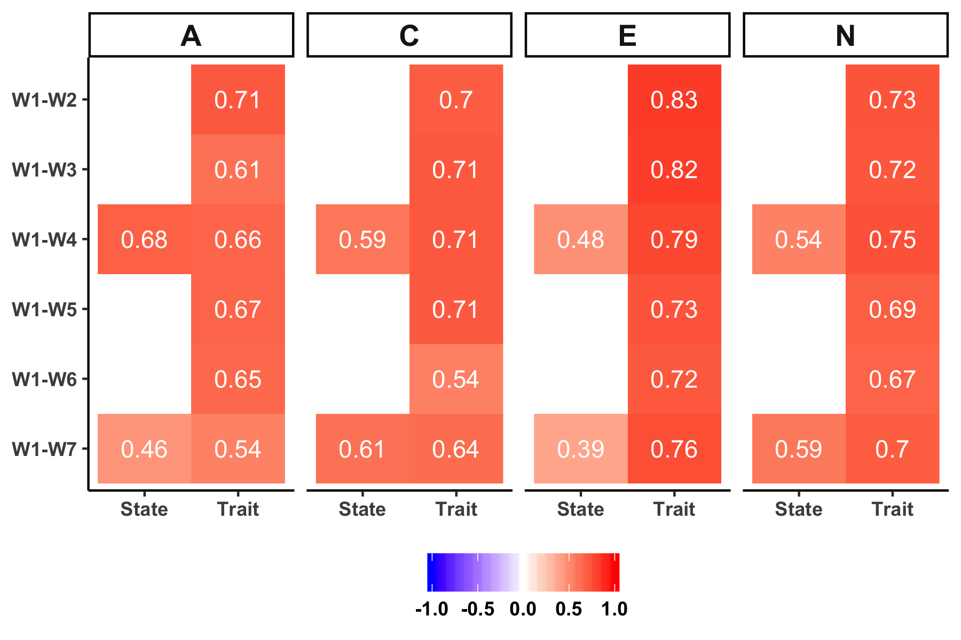
Test-Retest Consistency
Test-Retest | Mean-Level Change | Slope Variances | Correlated Change
Notes:
relative consistency at the trait level with the kinds of decreases we would expect over time
also relatively strong at the state level

Slide 13
Mean Level Change
Test-Retest | Mean-Level Change | Slope Variances | Correlated Change
Notes:
So moving into our results, first we will look at mean level change, so again we are looking at a single average trajectory for each triat across the study period

Slide 14
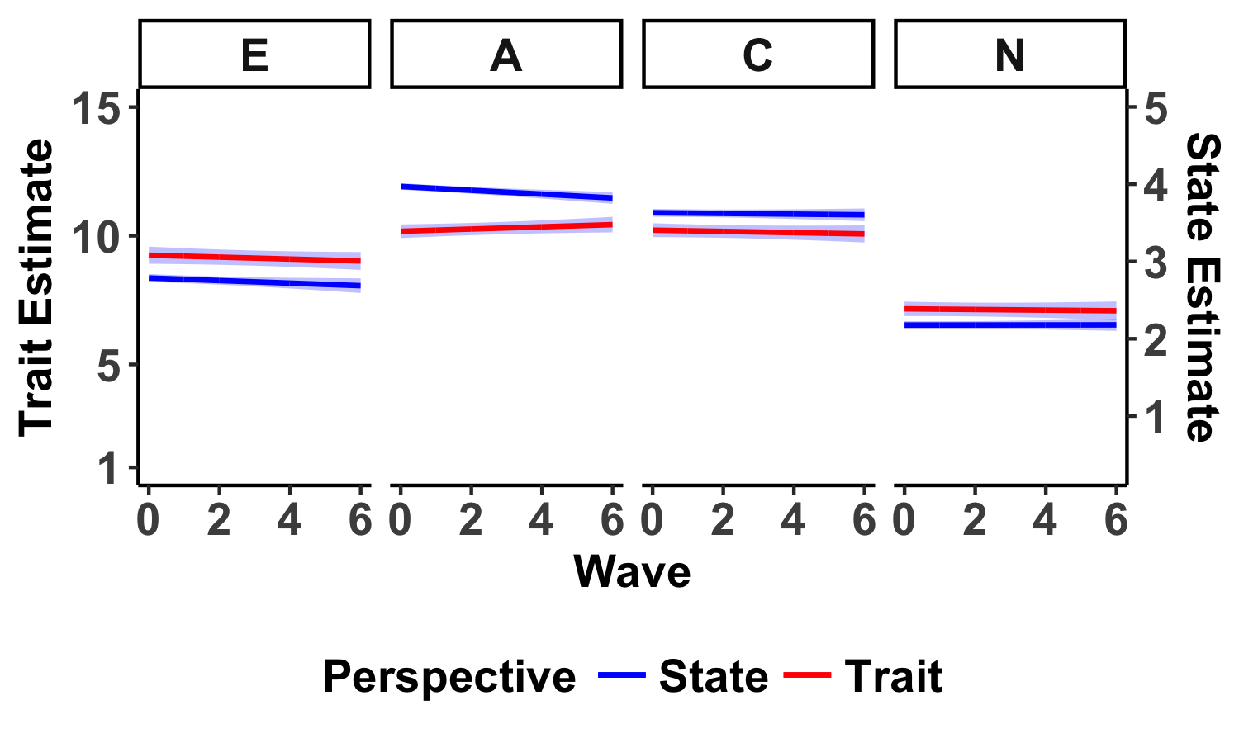
Test-Retest | Mean-Level Change | Slope Variances | Correlated Change
Mean Level Change
Notes:
To orient you to the graph I’ll show, you’ll see we have the Wave (1 to 7) on the x axis, separate Y axes for trait measures, which were on a 15 point scale, and state measures, which were on a 5 point scale, and the 4 Big 5 meausures we included in different panels. State level trajectories will be shown in blue, while trait level trajectories will be shown in red. As we go through I’ll flag the significant trajectories with obnoxisou yellow arrows
[explain]
So this is all well and good, but it raises a question of just how well these single lines capture any single individual. To examine this, we can look at individual level trajectories as well as the variances of the random slopes

Slide 15
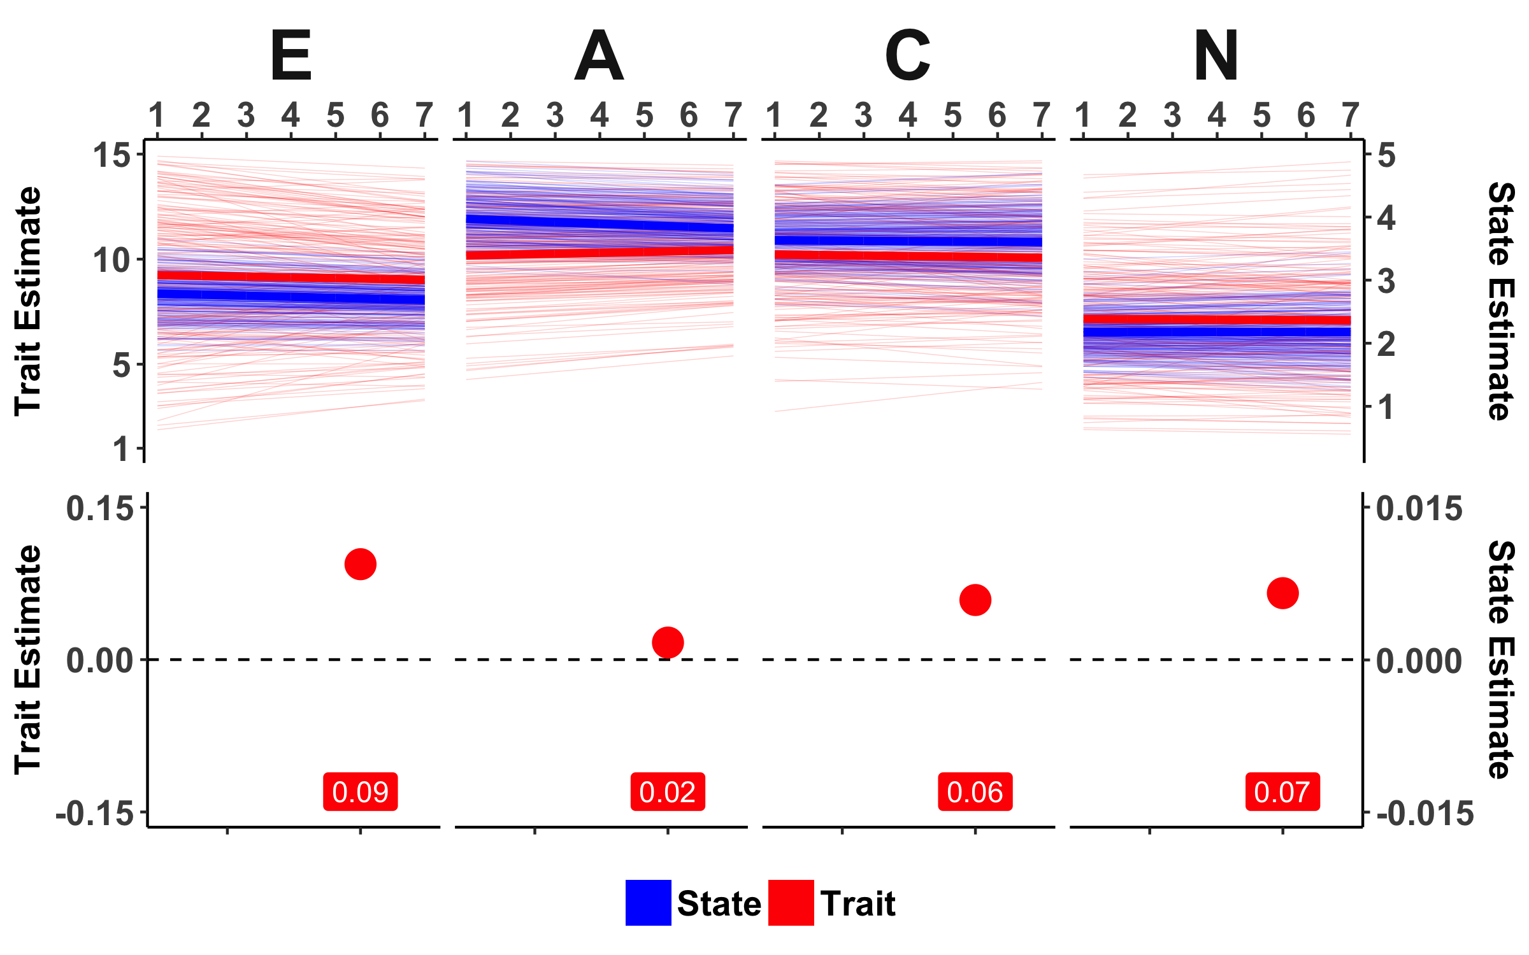
Slope Variances
Test-Retest | Mean-Level Change | Slope Variances | Correlated Change
Notes:
So here we see all the trajectories. Thin red lines are individual level trait trajectories, while thin blue lines are the individual level state trajectories. The thick lines are identical to the lines we saw on the previous figure. Clearly, there is a large amount of individual differences in both personality as a whole as well as the magnitude and direction of personality change.
These plots give us some insight into how much variability we saw at the individual level, but we can also calculate the variability of individual level change, as well as our precision in estimating it

Slide 16
Slope Variances
Test-Retest | Mean-Level Change | Slope Variances | Correlated Change
Notes:
Relative to the average slope, we see somehwat considerable variance in trait level slopes for E, C, and N but not A

Slide 17
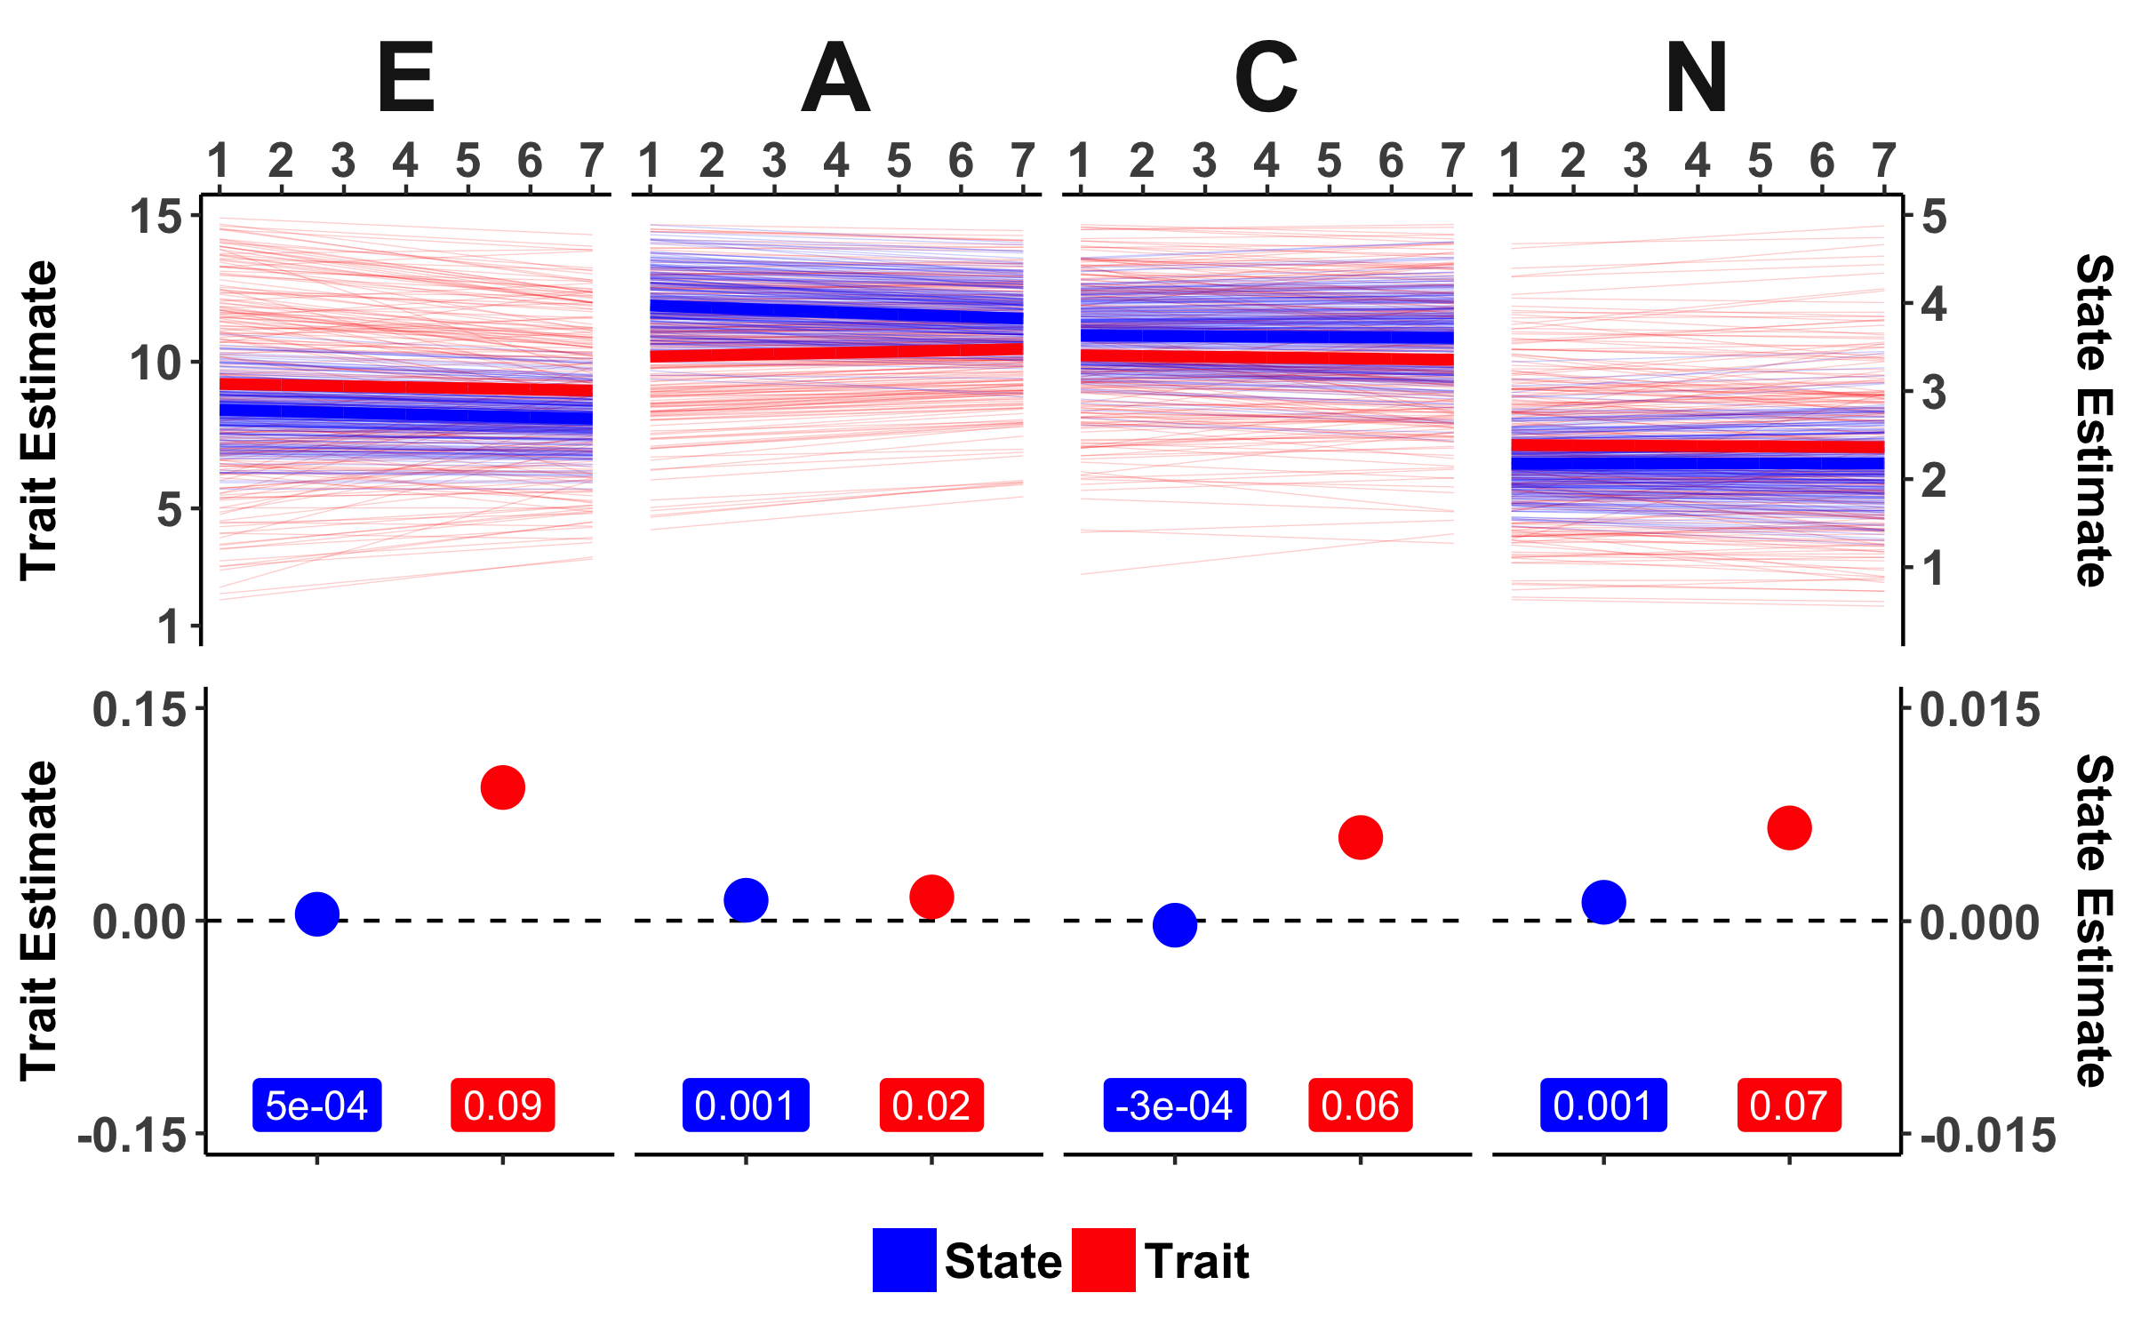
Slope Variances
Test-Retest | Mean-Level Change | Slope Variances | Correlated Change
Notes:
Relative to the average slope, we see somehwat considerable variance in trait level slopes for E, C, and N but not A

Slide 18
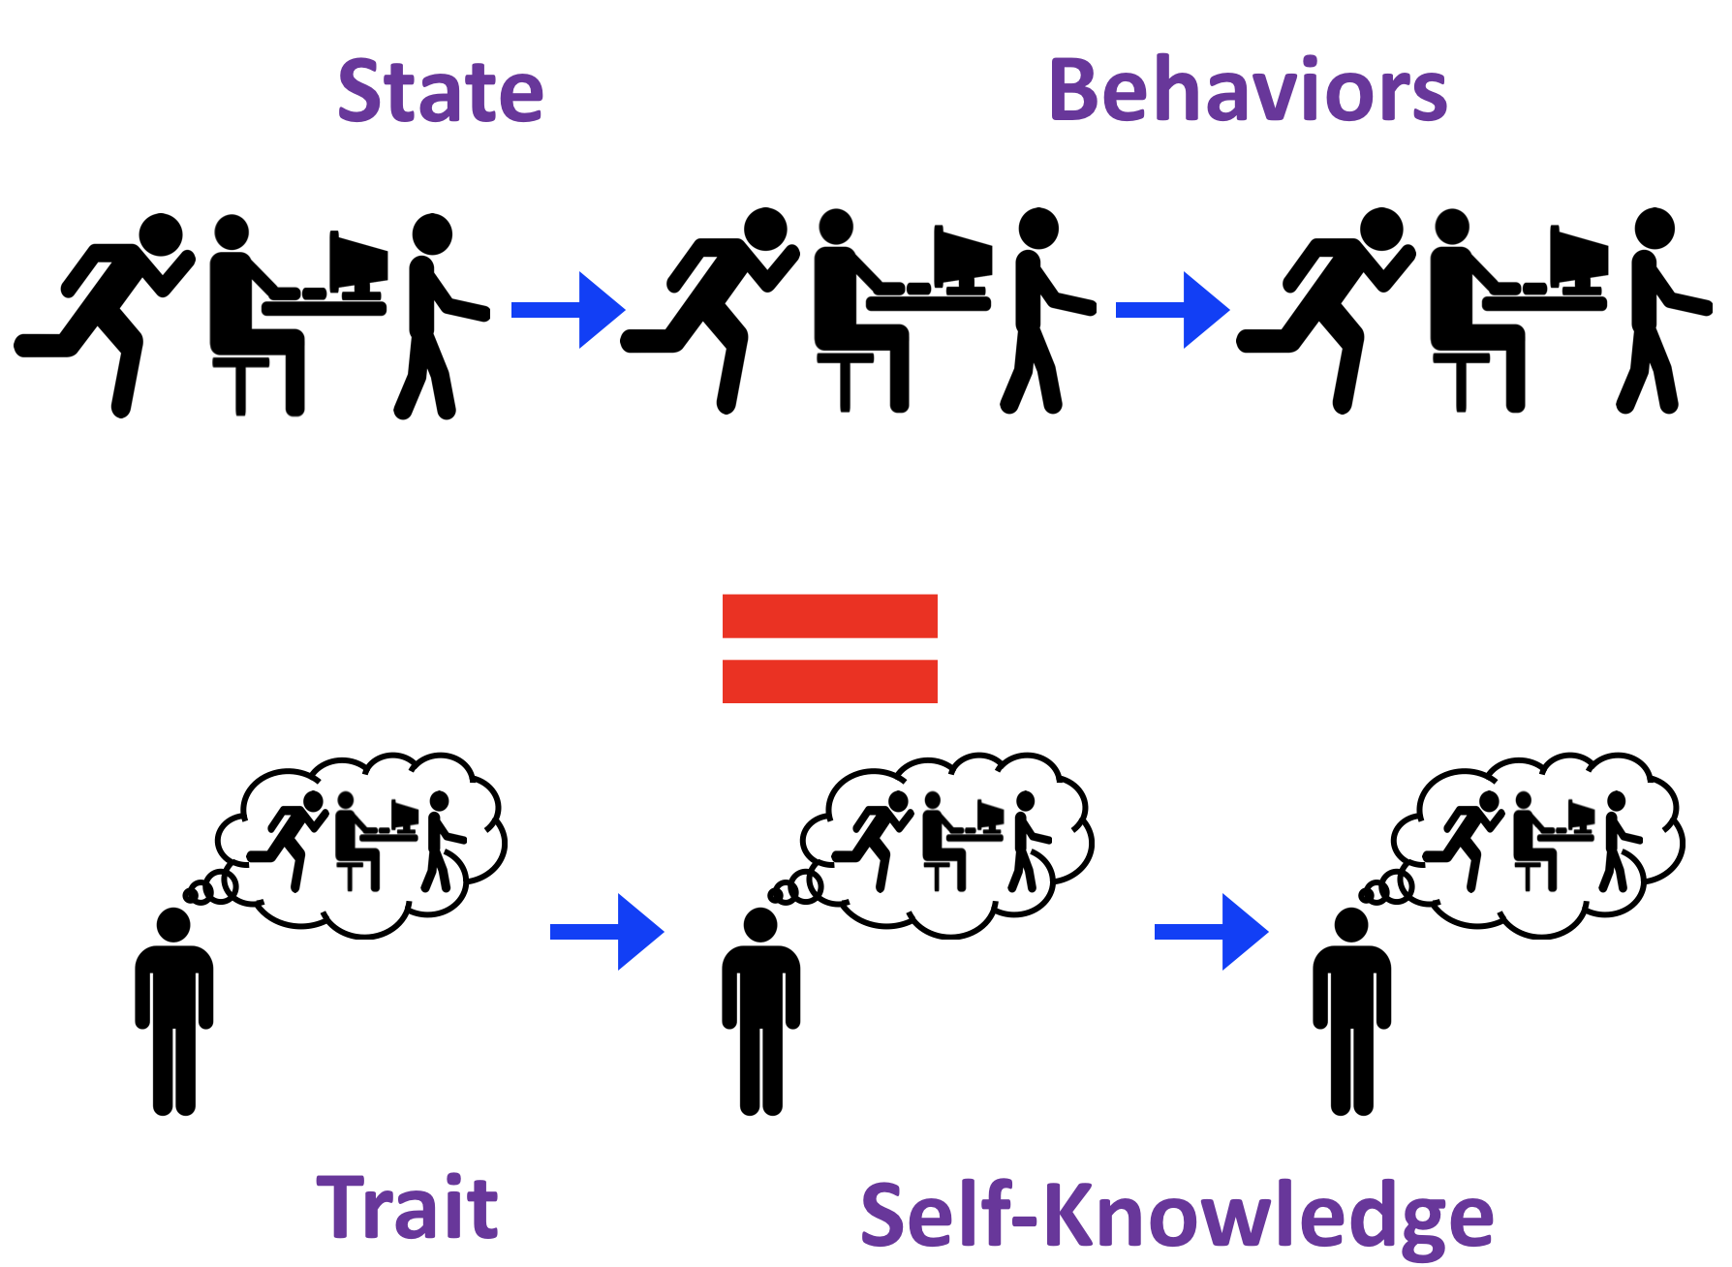
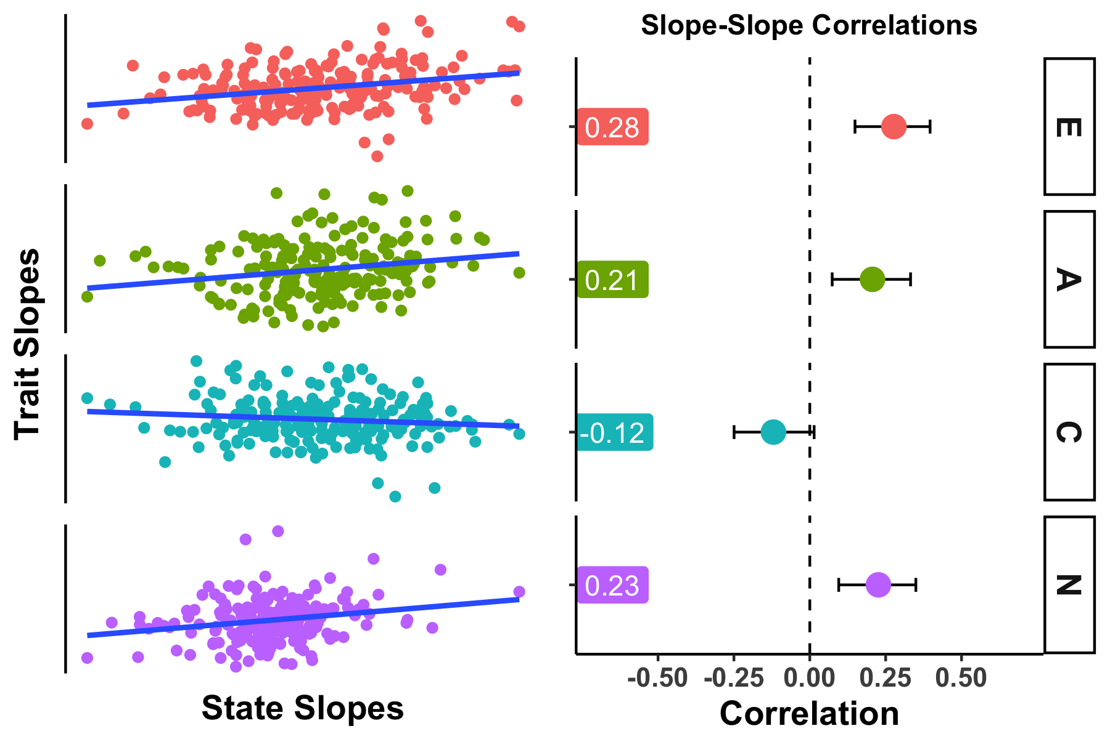
Test-Retest | Mean-Level Change | Slope Variances | Correlated Change
Correlated Change
Notes:
Finally, and most excitingly, we can look at whether the individual level state and trait trajectories track one another in maginitude and direction. Remember that this is a test of whether our behaviors match our knowledge of ourselves over time. On this graph, I’ll show you for correlations, one for each of the 4 Big 5 traits we examined. The correlation will be on the X axis, and I’ll show you both confidence intervals around the estimates and the values.
For extraversion, we see significant correlated change between state and trait measures. We also see this for Agreeableness and Neuroticism, but not Conscientiousness.

Slide 19
Conclusions
States can be used to measure personality change.
Mean-level change: not a lot in this sample
Variances: More variability in trait slopes → people think they are more mutable than they are
Correlate Change: Moderate slope-slope correlations → change isn’t just in your head
Notes:
First and foremost, this study demonstrates that we can assess personality to study personality change. As such, we see the need for more longitudinal studies of state level assessments using ESM, EMA, or other similar methods.
But zooming in on the specific results of this study:
For mean level change, we aren’t seeing a lot of consistent change in this undergraduate sample. This could just be because 2 years is a short time frame. But we do see change at the state level, which might suggest they are more sensitive than trait assessments to change
For the variances, we see more variability in trait measures of change, which could mean that people think they are more mutable than their behavior reflects
But to make that claim, we have to examine correlated change, which suggests that there are moderate slope-slope correlations. In other words, individuals who report dispositional changes do appear, at least in part to reflect these changes in the manifestations of their personality in everyday life
But of course there are limitations. We can make no claim about whether state level change mediates trait level change. Our sample also suffered from attrition and was limited to undergraduates, who are undergoing social changes that are not typical at other points in the lifespan. Thus, we demonstrate that state and trait level assessments of personality do reflect one another but to better understand the mechanisms driving personality change, we challenge personality scientists to collect longitudinal state level assessments among adults across the lifespan.

Slide 20
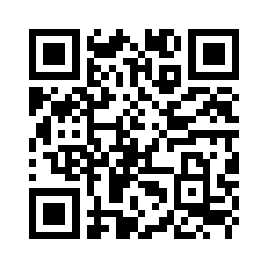
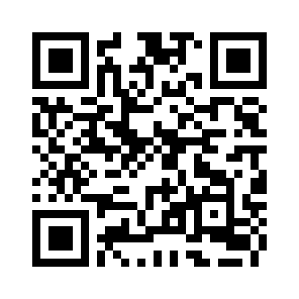
Questions?
Special Thanks to:
Josh Jackson
The PMaD Lab
(And the people who brought us PAIRS data)
Results:
https://pmdlab.wustl.edu/Beck_SPSP_2018.html
Data and Code:
https://github.com/emoriebeck/Trait-State-Correlated-Change

